Slide 1


All About Workload Identities
Bradford Cloud User Group | March 2022
Shannon Kuehn
Senior Program Manager
Identity and Network Access Advocacy
Twitter: @shankuehn
LinkedIn: https://www.linkedin.com/in/shannonkuehn/

Slide 2
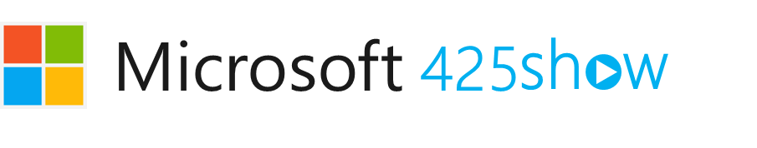






The Advocacy team is looking for tech influencers.
Live Streamers
Content Creators
Social Media Influencers
Bloggers
Learn More: https://425show.com
Contact: 425show@microsoft.com

Slide 3
Workload Identities

Slide 4
Taxonomy of identities in Azure AD
Employees
Human identities
External users
Service accounts
Non-human identities
Devices
Internet of Things
Workloads
Applications, service principals, managed identities, scripts

Slide 5

What are workload identities?
Definition: A workload identity is an identity used by a software workload (such as an application, service, script, or container) to authenticate and access other services and resources.
In Azure Active Directory (Azure AD), workload identities are:
An application
A service principal
A managed identity

Slide 6
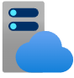

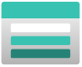

How are workload identities used?
Here are some ways that workload identities in Azure AD are used:

Slide 7
Workload Identity Public Previews

Slide 8
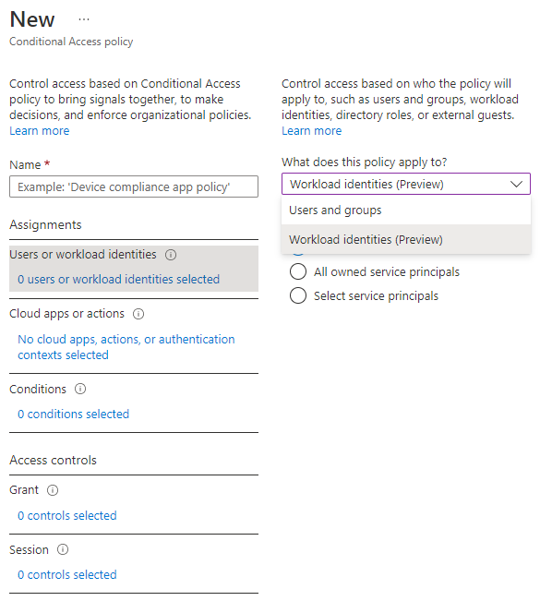
Conditional Access for workload identities
Extend Conditional Access policies to apps and service principals
Restrict access from named locations and Azure Virtual Networks
View service principals blocked by policies using Insights and Reporting workbook
Public Preview

Slide 9
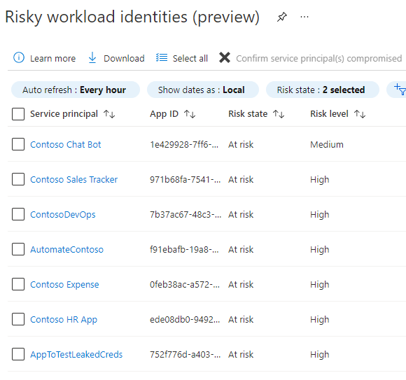
Identity Protection for workload identities
Detect compromised apps and service principals
Block access on risky workload identities in Conditional Access
Export risk logs using Diagnostic Settings (e.g., for SIEM tools)
Public Preview

Slide 10
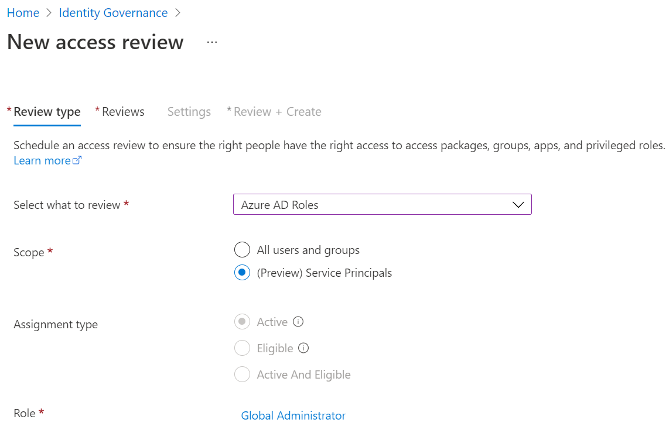

Access reviews for workload identities
​Schedule reviews of service principal assignment to Azure AD roles and Azure subscription roles
Delegate the reviews to the right people, then automatically revoke access of service principals denied by reviewers
Public Preview

Slide 11
Workload Identity Federation

Slide 12
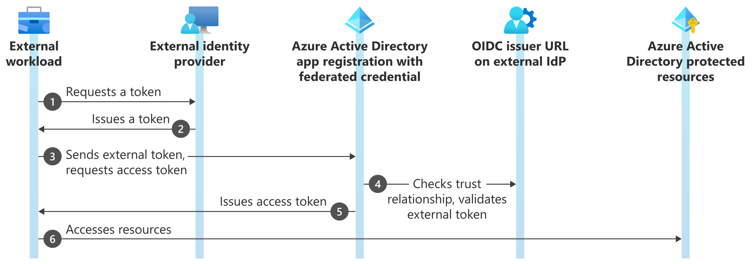
Workload Identity Federation
Allows you to access Azure Active Directory (Azure AD) protected resources without needing to manage secrets

Slide 13
Workload Identity Federation – Supported Scenarios
GitHub Actions
Google Cloud
Workloads running on Kubernetes
Workloads running in compute platforms outside of Azure

Slide 14
Demo

Slide 15
Workload Identity Federation – Supported Scenarios
Microsoft Documentation
GitHub Documentation
Jon Gallant GitHub Code

Slide 16
Resources

Slide 17
Resources
Microsoft docs pages:
Workload identities - Microsoft identity platform | Microsoft Docs
Workload identity federation - Microsoft identity platform | Microsoft Docs
Azure Active Directory Conditional Access for workload identities preview | Microsoft Docs
Create an access review of Azure resource and Azure AD roles in PIM - Azure AD | Microsoft Docs
Securing workload identities with Azure AD Identity Protection Preview | Microsoft Docs

Slide 18
Thank you

